Slide 1
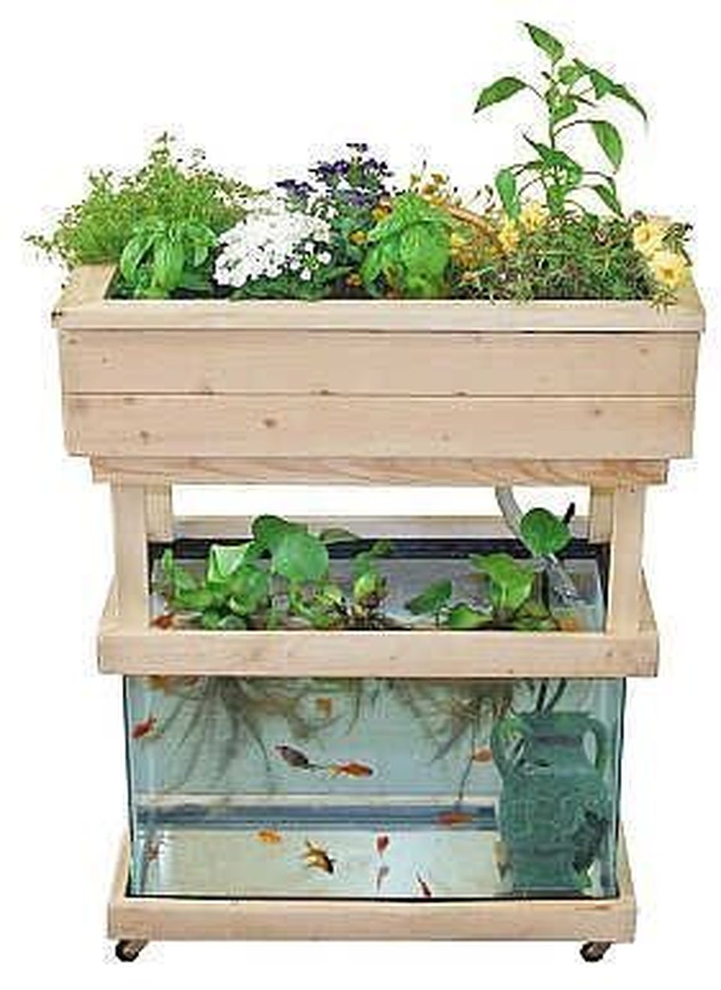
Aquality Organic Food
Aquaponics Cultivation and Marketing
Name/Course/registration Number

Slide 2
Location: West Bengal
Head office and Site Office –Santoshpur
Deal in fishery and agriculture industry by cultivating fishes and vegetables through an innovative technology
Supporting
Economic development
Community support
Environmental sustainability
Indulge in production as well marketing of produce
Indulge in exports of produce also

Slide 3
Unique experience to buyers through walk-in purchases from live fishery and farms
Promoting Healthy Eating - organic and clean
Conserve Water and Chemical Free
Production is less space

Slide 4
Fish is a local delicacy of West Bengal and consumed in both rural and urban areas forming the major target market
Fish exports to markets like Japan, Dubai and China
Fresh produce to be sold in supermarkets and local markets across West Bengal and neighbouring areas

Slide 5
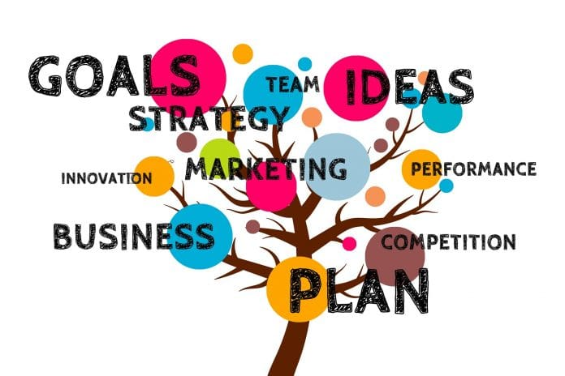
THE INITIAL PLAN
Focus on local markets
Reasonable pricing for quality products
Fresh products through innovative technology
Recycling waste products thus minimising carbon footprint
Promotion
Healthy lifestyle
environment sustainability through saving water and soil
Chemical free produce (organic in nature)
Online presence to enhance awareness and marketability

Slide 6
References
Chakravartty, D. et al., 2017. Role of aquaponics in the sustenance of coastal India –Aquaponics is a solution for modern agriculture in ecologically sensitive Indian mangrove Sundarbans: A Review. International Journal of Fisheries and Aquatic Studies , 5(2), pp. 441-448.
Dash, D., 2014. Lakshadweep tops in fish consumption, Bengal 4th. [Online] Available at: https://timesofindia.indiatimes.com/india/Lakshadweep-tops-in-fish-consumption-Bengal-4th/articleshow/41653393.cms [Accessed 28 June 2018].
Ghosal, S., 2017. West Bengal govt bags Rs 900 cr order to export fishes to Dubai, Japan, China. [Online] Available at: https://economictimes.indiatimes.com/news/economy/foreign-trade/west-bengal-govt-bags-rs-900-cr-order-to-export-fishes-to-dubai-japan-china/articleshow/57856311.cms [Accessed 28 June 2018].
One Notch Up Labs LLC, 2018. Welcome to Aquaponics In India. [Online] Available at: http://aquaponicsinindia.com/ [Accessed 28 June 2018].
Patwardhan, A., 2018. In a First for North India, Organic Farming Enthusiast Sets Up Aquaponic Farm in Gurugram. [Online] Available at: https://www.thebetterindia.com/76236/organic-farming-first-aquaponic-farm-gurugram-sushant-madaan/ [Accessed 28 June 2018].
Walker, C., 2017. Aquaponics: How to Build Your Own Aquaponic System and Successfully Grow Aquaponic Plants. North Charleston: CreateSpace Independent Publishing Platform.

